Slide 1
Elkins High School CCR & Counseling 11th & 12th Grade Parent Night
September 7th, 2021
6pm ( 11th) & 7pm (12th)
TEAMS Virtual Meeting

Slide 2
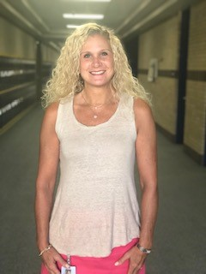
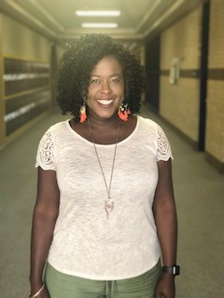
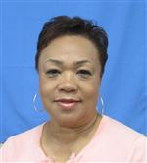
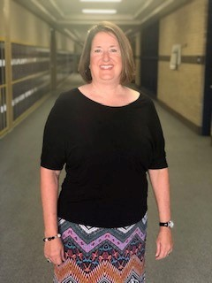
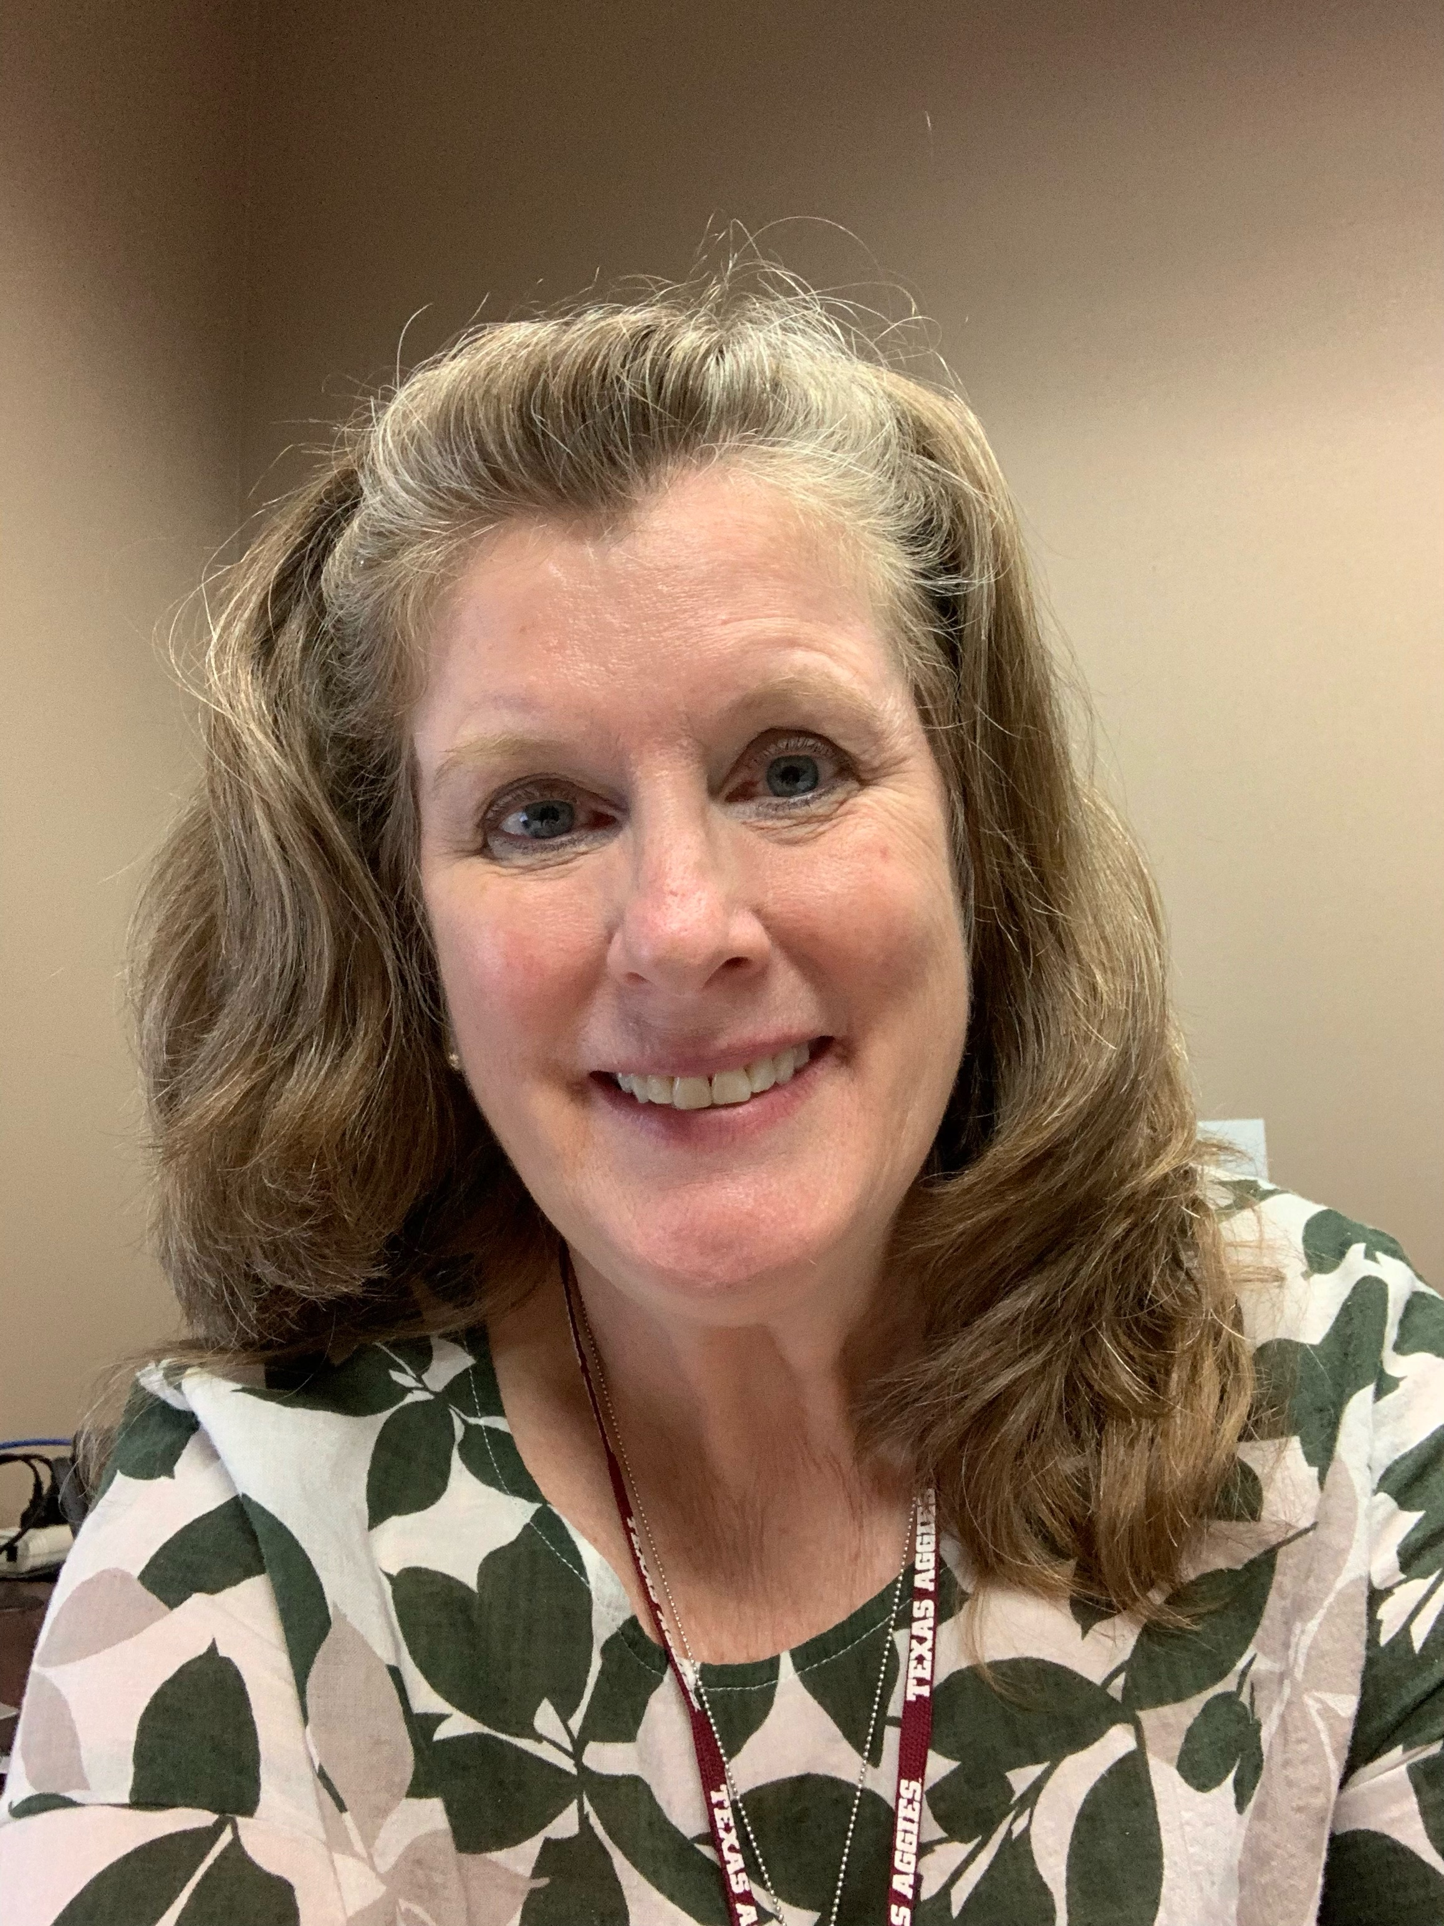
Please Meet our Counseling & CCR Staff
Audrey Wynne – Counselor Clerk
Andrea Adams – Counselor Clerk
Dina Powis – Lead Counselor Sn-z
Braiyon Sands
P-Sm
Richerica Wolf
Cl-G
Counseling Office – 402
CCR – Rm. 447
( next to dance room)
Jourdan Wortham
H-K
Kathleen
Fey
A-Ck
Georgia Hicks
L-O

Slide 3
Upcoming College & Career Focused Programs
Senior visits w/CCR & assigned Counselor
Occurred last week where students learned how to apply to college and everything that goes along with it.
District College Fair – Oct 7th & Oct 15th – Great Sessions & More Info. for Virtual Log-in to Come
( Flyers & Log-in Instructions coming soon)
Want to play collegiate level sports?: NCAA Clearinghouse Virtual Presentation
Date is forthcoming– ( Flyers & Log-in Instructions coming soon)
September 30 – On-line Virtual FAFSA Night (How to)
Fort Bend ISD FAFSA & TASFA Parent Night with Lori Blust from WCJC

Slide 4
See what we say!
Video https://youtu.be/r-Yn4b9iClE - Stop @ 3:45
Video 2 https://youtu.be/bvteruuBknA

Slide 5
Let us Help you Help your students become their OWN ADVOCATE
Let Go Video https://youtu.be/r-Yn4b9iClE - Stop @ 3:45
Allow Us to Help Your students become college ready: Video 2 https://fortbend-my.sharepoint.com/:u:/r/personal/elias_reyes_fortbendisd_com/Documents/Open%20Door/Open%20Door.zip?csf=1&web=1&e=Qogt1t

Slide 6
Email Etiquette
We don’t know who is emailing us many times. Tell us who you are.
PROPER SALUTATION - Always start out your email with a polite “Dear” or “Hello” followed by your teacher’s name/title (Dr. XYZ, Professor XYZ, etc.).
Tip: If you want to know their proper title, check the class syllabus!
INTRODUCE YOURSELF - Even if your teacher knows who you are, it can never hurt to give a brief introduction. Simply giving your preferred name, year, major, and the course you’re enrolled in can provide a great deal of context.
USE CORRECT GRAMMAR AND SPELLING - An email is more formal than a text or message on social media, so be sure this is reflected in your writing (no abbreviations/acronyms). Be sure not only to use spelling/grammar check, but also proofread the email. You can even ask a friend or roommate to give it one final read-through.
USE A FORMAL CLOSING - Conclude your email with a closing, such as “Best regards”, “Sincerely”, or “Thank you” followed by your name.
Tip: Set up a signature on your Purdue email account that include your full name, major, and intended graduation year. To learn how to do this, click here.
EXAMPLE EMAIL TO A Faculty Member/Counselor:
Dear (Mr., Ms., Dr.) Smith, My name is Emma Jones and I am a sophomore in your Tuesday/Thursday General Physics Class. I am writing because in class yesterday you mentioned having some open positions in your research lab. I found the summary of your project very interesting, and I would like to learn more and possibly talk to you about joining the lab. Is there a time in the coming weeks that we could meet?
Thank you for your time and I look forward to hearing from you soon!
Best regards, Emma Emma Jones Student ID: 123456 Applied Physics, Class of 2022
*https://www.purdue.edu/advisors/students/email.php

Slide 7
11th Graders PSAT NMSQT Oct 13th
Study 30 minutes a day until PSAT & take free practice exam in simulated testing room
What does that look like?
Why is the PSAT so important?
What does a good PSAT score usher in?
Try to incentivize your students to study for the upcoming exam

Slide 8
Test Optional, Test-Flexible, & Test-Blind
A test-optional college lets students decide whether they want to submit test scores with their application. Most test-optional schools will consider SAT and ACT scores if they are submitted, but focus on other factors they believe are stronger predictors of a student’s potential to succeed in college. These schools look at a student’s essays, recommendations, grades, and coursework just as (or more) closely than your test scores.
A test-flexible college lets students submit other test scores in place of the SAT or ACT, such as one or more SAT Subject Tests, an International Baccalaureate exam, or Advanced Placement test.
A test-blind college will not consider test scores, even if you submit them.
Determine if the college you are applying to is test optional or test blind:
https://www.fairtest.org/
Test-Optional Policies Differ from College to College
Some test-optional policies come with restrictions. For example:
Some colleges require test scores for out-of-state or international students, or for students pursuing certain majors.
Some test-optional schools may determine your test-optional eligibility using an index calculated from your GPA, test scores, and class rank.
Some schools may ask you to submit test scores for placement in the freshman class or to take a placement exam.
Some may ask for additional materials instead of test scores, such as samples of your academic work, scientific research, or additional recommendation letters.
Due to COVID-19, many colleges have changed or lifted some of these restrictions, so be sure to check with the college to confirm how it will use test scores in the admissions process.
Other Parts of Your Application Will Be Closely Scrutinized
Colleges want as much information about you as possible. So without test scores, it’s likely that other parts of your application -- your grades and grade trends, essays, extracurricular activities, and achievements -- must be strong enough to make the college want to admit you.

Slide 9
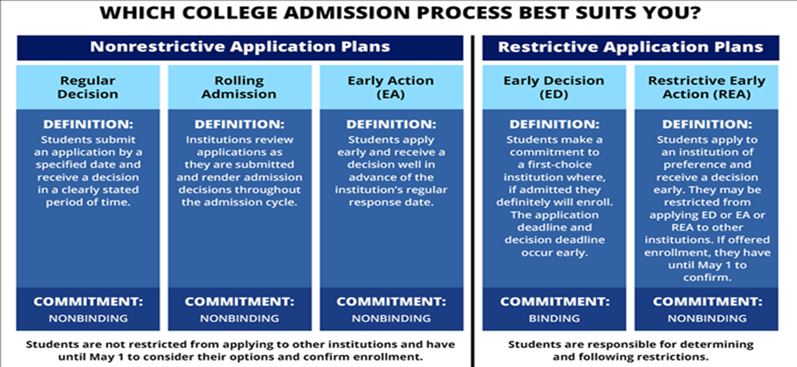
Let us Help you Help your students become their OWN ADVOCATE
Video https://youtu.be/r-Yn4b9iClE - Stop @ 3:45
Video 2 https://youtu.be/bvteruuBknA

Slide 10
11th Graders Students Need to Identify 6-10 colleges
Use Naviance’s SuperMatch after receiving PSAT test scores
@ least 2 Safe Colleges/Universities/military Branches/Technical Schools
@ least 2 Target Colleges/Universities/military Branches/Technical Schools
@ least 2 Reach/Dream Colleges/Universities/military Branches/Technical Schools
Safety schools are those that you will almost certainly get accepted at.
Target school tis one in which your profile is competitive with that of admitted students.
Reach school/Dream School is a stretch for you—your grades, test scores and overall profile are lower than what the school lists as its student profile.
2 excused college visits
Visitor’s Center & Attendance Office are involved
Date your colleges with summer programs/camps/tours
*How to determine what colleges are safe, reach, or dream – Look at “College Super Match” results after entering in prospective college major and degree type, pro, sat/act scores, GPA, etc. List generated will show the likelihood of you being admitted.

Slide 11
12th Graders Students Need to Apply to 6-10 colleges
@ least 2 Safe Colleges/Universities/military Branches/Technical Schools
@ least 2 Target Colleges/Universities/military Branches/Technical Schools
@ least 2 Reach/Dream Colleges/Universities/military Branches/Technical Schools
Safety schools are those that you will almost certainly get accepted at.
Target school tis one in which your profile is competitive with that of admitted students.
Reach school/Dream School is a stretch for you—your grades, test scores and overall profile are lower than what the school lists as its student profile.
*Apply for colleges that train you for your future career. If the college does not have your major you should reconsider applying to that college.
*How to determine what colleges are safe, reach, or dream – Look at “College Super Match” results after entering in prospective college major and degree type, pro, sat/act scores, GPA, etc. List generated will show the likelihood of you being admitted.

Slide 12
Virtual College Fairs – Sign Up Today
Sign-up Here:
Events | NACAC Fairs (virtualcollegefairs.org)

Slide 13
11th & 12th - Let the Search Begin – Family Dinner Discussion Times
Set the mod for a great/in-depth discussion
Have open conversations about college at home
What are you looking for in a school? What is the best fit?
Is a 2 year school or 4 year school the better choice for my student? Considerations:
Student’s maturity/responsibility
How did my student fare in high school?

Slide 14
Seniors - Discussion with your student
Work with them to think about who they will ask for letters of recommendation
Be aware that all Common Application school requires a letter from the counselor, some state colleges do not. Only request if you need for school or for scholarships
Letter of Rec. fillable form & resume ( send both by email to recommender 2 weeks in advance) & request via Naviance
Counselor’s Letter of Rec. fillable form, resume, ( send both by email to recommender 2 weeks in advance) & request via Naviance
What would you like to major in?
By using Naviance to review the Strengths Explorer/Career Interest Profiler & College Super Match Activity Results.

Slide 15
Scholarships
Apply for Scholarships NOW!
Find in Naviance – SCHOLARSHIP LIST OR NATIONAL SCHOLARSHIP SEARCH
Make sure that your child is on Class of 2022 Remind – To stay in the know
Sign-up will go through Senior English class & Naviance
Follow EHS CCR on Twitter to get up to date scholarships @CCRElkinsHS
Report any scholarship offers to CCR Advisor @ Narietha.cartermccla@fortbendisd.com – If you applied to school or not
Have your student sign-up for Raise.me for scholarship opportunities
RaiseMe is a platform that helps 9-12th grade students prepare for college by earning scholarships for their achievements in high school. Over 250 colleges and universities have partnered with RaiseMe, and award micro-scholarships for both academics and extracurricular activities.

Slide 16
FAFSA – Oct 1st
Steps to Take
( Complete by January 1st)
Must complete www.FSAID.ed.gov
@ least 2 days before
FSAID.ed.gov – Parent & Student Get FSA ID
Financial – Oct 1st FAFSA goes live (everyone should apply..period) FAFSA.ed.gov.
Fun videos - https://youtu.be/Ms1FXsyWgXw
MyStudentAid Mobile App is now available

Slide 17
TASFA– Oct 1st
TASFA ( Due January 1)
If you are not a US Citizen, but are a Texas resident then complete the TASFA
http://www.collegeforalltexans.com/index.cfm?objectid=A3119543-CBF8-C202-F1B0EEFD5F4B9805

Slide 18
CSS Profile

Slide 19
3 College Application Systems Used @ EHS
www.Applytexas.org
https://www.commonapp.org/
DO NOT use Common App for University of Houston
https://commonblackcollegeapp.com/ -
Black Common App - Only costs $20 for students to apply to all 56 of its affiliated colleges.
Have not identified a Historically Serving Institution common app or Indenginous common app
Coalition Apps are NOT used @ EHS due to lack of user friendliness

